Slide 1
UNITY OF LOUISVILLE
2021 ANNUAL MEETING
FINANCIAL REPORT FOR 2020

Slide 2
CLASP Committee: Congregant Led Advisers to Strategic Planning
Leah Zellers; Unity of Louisville Annual Meeting
3/21/21

Slide 3
Overview
CLASP Purpose
To determine what we are already doing that is aligned with the strategic plan (intermittent work).
Identify areas for growth & address challenges we have experienced as a collective (intermittent work).
Share creative new ways to move forward in alignment with the strategic plan (ongoing/continued work).
Integrity, Service, Faith, Diversity, Equity, and, Inclusion
“What goes and what grows?”

Slide 4
Key Observations & Insights
Shifting Collective Consciousness to Love and Abundance
Meeting People Exactly Where They Are
Expanding our understanding of Diversity, Equity, and Inclusion
Love for this commUnity inspires creativity & new growth

Slide 5
Defining Values & Principles
Equity--
To become equitable requires the recognizing and removal of barriers to equity. Not to be confused with “equality”.
Integrity--
words and actions are in alignment
Faith--
courage to step into the unknown
Inclusion--
We are One, embracing and celebrating our differences; being aware of and including others differences and needs
Service--
Christ consciousness, mindfulness of WHO I’m in service to, stepping out of ourselves
Diversity--
-required for a healthy ecosystem, accepting people exactly where they are, celebrating differences

Slide 6
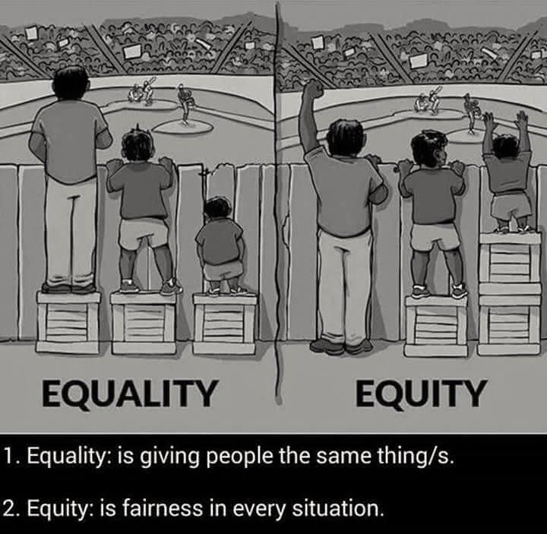

Slide 7
MINISTRIES AUDITED
Board of Trustees
Finance Committee
Worship Ministry
Music Ministry
Ushers
Pastoral Care
Prayer Chaplains
Energy Works
Fillmore Prayer Circles
Adult Education
Youth and Family
Outreach
MINISTRIES NOT YET AUDITED/ON HOLD
Divine Love Stitched Through Me
Office Ministry
Serenity Hikers
UniLunch
Bread Works
Special Events Ministry
Hospitality Team
Welcome Ministry
Development
Garden Ministry
Building Ministry
Grief Group
Men’s Group
Mom’s Group

Slide 8
Action Items
Marketing dollars
Inviting Zeal & enthusiasm; being the hands and feet
Data Gathering

Slide 9
2020 FINANCIALS
Income: 2020 2019
Contributions: $172,800.66 $254,770.22
Education: $ 19,883.55 $ 34,949.12
Events: $ 6,639.59 $ 9,917.95
Youth & Family: N/A $ 5,131.48
Misc. $ 6,651.80 $ 15,223.29
Total: $205,975.60 $319,992.06

Slide 10
2020 FINANCIALS
Expenses: 2020 2019
Admin: $ 46,446.15 $ 44,467.86
Education: $ 9,791.83 $ 14,782.60
Payroll: $150,004.49 $199,459.00
Utilities: $ 16,406.99 $ 23,952.43
Misc. $ 40,681.27 $ 47,400.72
Total: $263,330.73 $330,062.61

Slide 11
2020 FINANCIALS
Net Income: 2020 2019
Income: $205,975.60 $319,992.06
Expenses: $ 263,330.73 $330,062.61
Net Income: $(-57,355.13) $(-10,070.55)
PPP Loan: $ 35,800.00
Net Loss: $(-21,555.15)

Slide 12
2020 FINANCIALS
Other Non-Operational Income:
Foundation: $ 9,000.00
Other Gifts: $ 215.00
Generosity: $ 43,927.50
Total: $53,142.50

Slide 13
2020 FINANCIALS
Cash Balances 12/31/2020:
General Fund: $ 5,090.00
Savings: $ 378.59
Generosity: $102,249.85
Other: $ -1.48
Total: $107,660.96

Slide 14
2020 UNITY FOUNDATION REPORT
Note: Unity of Louisville Foundation is a separate organization
(not part of Unity of Louisville)
Account Information provided for informational purposes only.
Balance 21/31/2020: $6,505.44

Slide 15
2021 BUDGET
Given the unusual times we are dealing with:
Building under contract, not sure where we are going at moment
COVID-19 & no church services.
We did not create a budget.
We are using 2019 and 2020 numbers as the reference point.

Slide 16
Post COVID-19 Collaboration
Creating a greater Unity Experience in Kentuckian

Slide 17
UNITY OF LOUISVILLE
2021 BOARD MEETING
FINANCIAL REPORT FOR 2020

Slide 18
Unity in Louisville

Slide 19
WHY to Reunite
Notes:
Unity Worldwide asked if we had thought about Reuniting the churches

Slide 20
Creating a greater Unity Experience in Kentuckiana
Shared Ministry
Fiduciary Responsibility
Worship, Classes, Groups
Marketing, Technology,
Staff & Volunteers
Facilities

Slide 21
Possibilities
Worship
Classes, Groups & Webinars
2 weeks in each location and livestream other two weeks
Two services at East when downtown is between locations
Wednesday night Kaleidoscope at East
Open to all who want to attend at either facility
Youth & Family for both churches
Hybrid classes and Webinars open to public

Slide 22
HOW to Reunite
Notes:
Unity Worldwide asked if we had thought about Reuniting the churches

Slide 23
Shared Teams & Committees
Pastoral Care, Chaplains & Prayer Groups
Sunday Worship
Classes & Webinars
Concerts
Administrative
Financial Relationship
Physical Space
Retreats

Slide 24
Thoughts
Strategic Plan started downtown
Comfort of small community East

Slide 25
Easter Service Outdoor at East April 4, 11 am

